Slide 1




IoT Router 101
Mel Gehrs
1/29/2016

Slide 2
AGENDA
Overview
Hardware
Login/Access
WinSCP & Putty, Ping, .PEM , .PPK, jump drive
ssn (pass:ssn) & root (pass: ‘see Mel’)
DHCP options
Tools
Unix Commands
Netmgr
Applications
Modbus, Advertising (Frame Buffer)
Read Netmgr commands

Slide 3
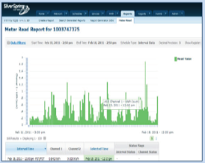
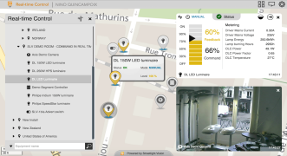
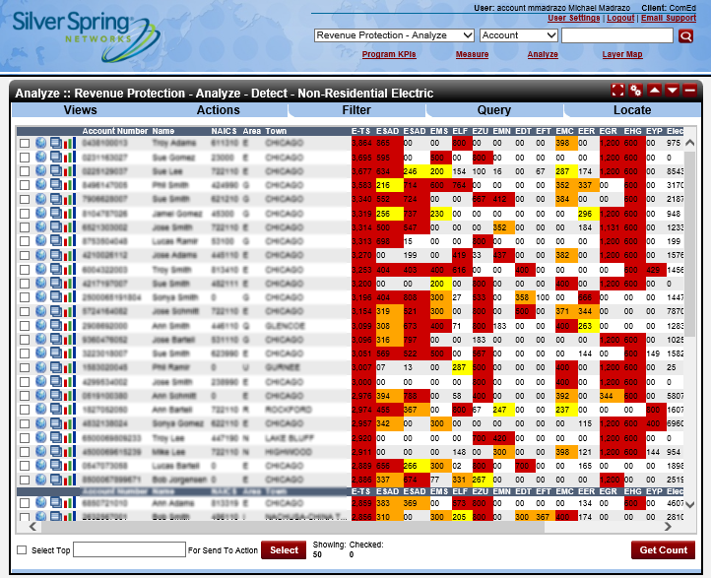

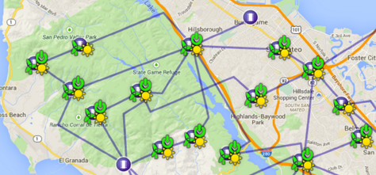
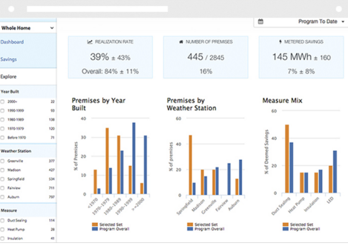
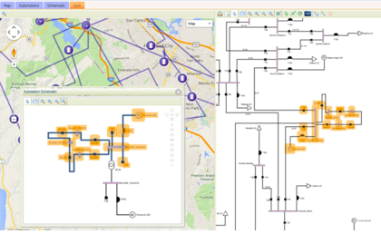
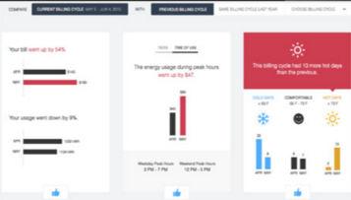



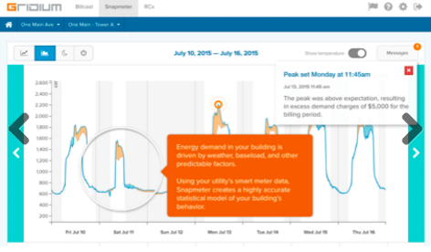
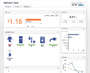






























SilverLink Solutions Diagram
SilverLink Applications
Third-Party Applications
Advanced Metering Manager
Data Visualization
SLV6
City Management
Operations Optimizer
Utility Analytics
CustomerIQ
Customer Engagement
SilverLink Data Platform
Third Party Data & Systems
SilverLink Control Platform
SilverLink Network Platform
WAN
ETHERNET
CELLULAR
ETHERNET
CELLULAR
MICROMESH
TECHNOLOGY
IoT
ANSI METER
IoT
IEC METER
ZIGBEE
WI-FI
BATTERY
MESH
Advanced Metering
Demand-Side Management
Distribution Automation
City Infrastructure
Notes:
SilverLink lays the foundation for a brilliant and interconnected smart grid and smart city through proven, standards-based solutions that are secure, flexible and reliable. With capabilities demonstrated for over a decade, utilities and cities worldwide trust SilverLink to enable their most critical applications. Silver Spring’s mesh network technology gives utilities and cities more choices, while ensuring the most efficient and scalable deployment path possible.
The SilverLink Network Platform is a suite of intelligent devices to connect critical infrastructure. This family of networking products includes endpoint devices such as Network Interface Cards (NICs), Interpreters, and Interface Management Units, as well as network equipment such as Edge Routers, Bridges, Access Points (APs) and Relays.
The SilverLink Control Platform provides the back office software required to provision, operate and troubleshoot a Silver Spring network. The Control Platform gives operators the flexibility to determine what data to gather, how often to collect it, and which devices to query, and it supports real-time data gathering to provide immediate insight into events. From network essentials such as security, domain name system (DNS) and traffic routing, to firmware management, network configuration and troubleshooting, the SilverLink Control Platform simplifies the task of managing a large-scale critical infrastructure network.
The SilverLink Data Platform is an application enablement solution that ingests, organizes and visualizes data from multiple internal and external systems. The platform provides modern tools to effectively manage the massive amount of data generated by high-capacity, distributed IoT networks. It enables real-time decision making and supports applications developed by Silver Spring, partners and within your organization. The SilverLink Data Platform enables an open ecosystem of applications. The platform automatically ingests real-time and historical device data, normalizes and enriches the data, and makes it secure and accessible to utilities and third parties through standard APIs. The platform also enables utilities to manage API keys, access to data, and data-usage analytics.
Flexibility and choice are key attributes of SilverLink Applications, which can be deployed stand alone, together, or in conjunction with other SilverLink platforms, such as the SilverLink Network Platform or Data Platform. Packaging applications with these platforms enables your organization to accelerate integration and deliver ongoing benefits due to our platforms’ ability to unlock high frequency and high granularity data to power advanced analytics. These powerful solutions provide actionable intelligence to improve the speed and accuracy of decision making, while providing insights that enable you to enhance the efficiency of your operations and build customer satisfaction. These applications provide a wide range of benefits to smart cities and utilities, supporting many varied use cases, to provide your organization with the maximum value.

Slide 4
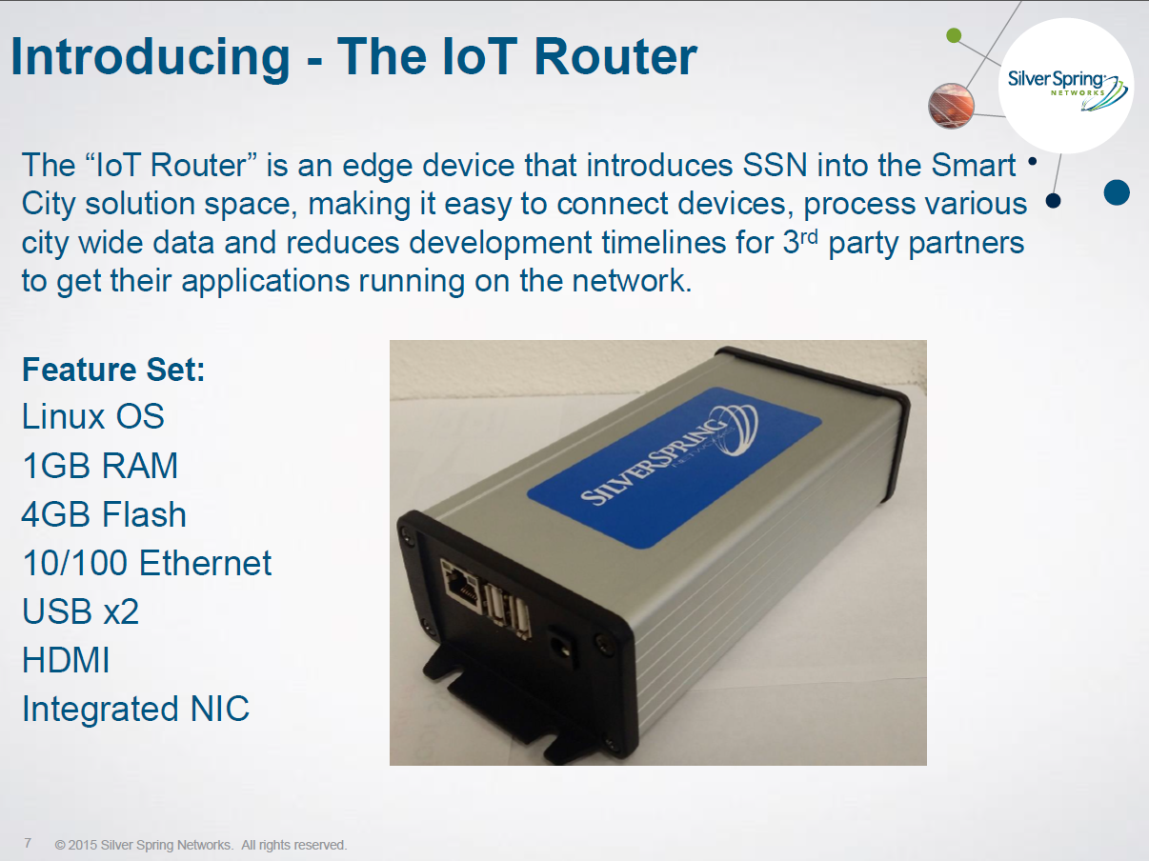

Slide 5
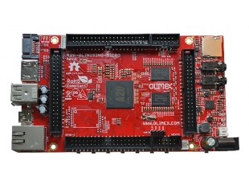
Core of the IoT Router
SATA connector with 5V SATA power jack
Built-in FullHD support (1080p)
2 x USB High-speed host with power control and current limiter
USB-OTG with power control and current limiter
HDMI output with ESD protectors
VGA output on 6-pin 1.25mm (0.05") step connector
100MBit native Ethernet
Battery connector with battery-charging capabilities
Audio output
Microphone input on connector
2 x UEXT connectors
LCD connector compatible with with 4.3", 7.0", 10.1" LCD modules from Olimex
160 GPIOs on three GPIO connectors
MicroSD card connector
SD/MMC card connector
DEBUG-UART connector for console debug with USB-SERIAL-CABLE-F
GPIO LED
Battery charge status LED
Power LED
2KB EEPROM for MAC address storage and more
10 BUTTONS with ANDROID functionality + RESET button
4 mount holes
6-16V input power supply, noise immune design
PCB dimensions: (5600 x 3250) mils ~ (142.24 x 82.55) mm
Support for NIC/mNIC integration
Easy development platform for SSN
and partners
Standard management support
Notes:
This is a development board, but illustrates the multitude of options available. We will not use all of them out the gate, but a solid development platform
Initial plan is;
Build 20 IoT Routers for development and test network
Design a base card that the A20 module sits on
NRE for an enclosure that is IP57 for the first rev
Build approx 200 to seed the deployment - Paris
Bret to look at his inventory – Prefer to have Nibrea NIC
Bill to send email to Development asking for 20 NIC’s
Bill to ping RB on NIC availability

Slide 6

Left Brain/Right Brain
UNIX - programming
SSN NIC - Network
Serial 38400 baud

Slide 7
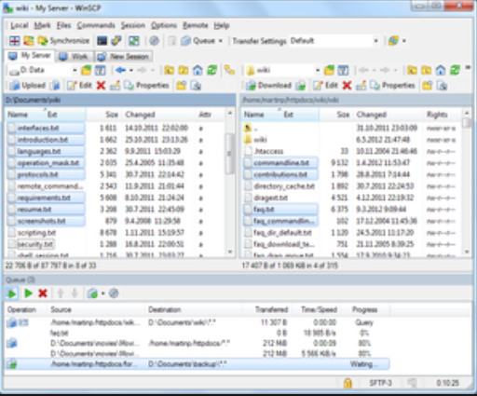
Jump Drive Contents
WINSCP Installation 5.8 ( + 5.7) Windows Secure Copy
File Interface to local machine and IOT router
Drop and drag
Uses PUTTY for command line
Putty SSH & Telnet Installation
PEM file – secure login to IOT
A20 Users Manual
Linux Command Summary
IOT Router 101 Presentation
Netmgr command summary

Slide 8
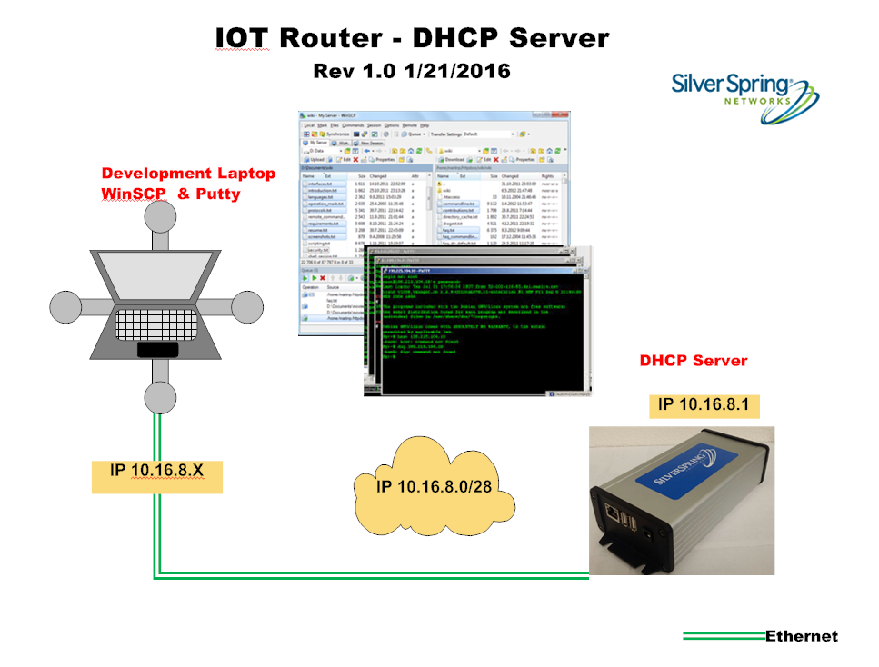

Slide 9
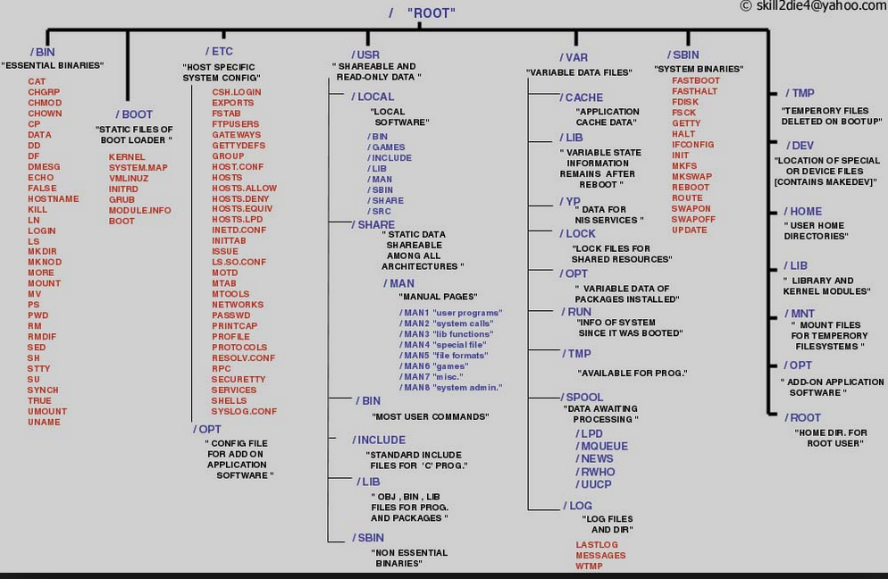
Linux Tree Structure

Slide 10
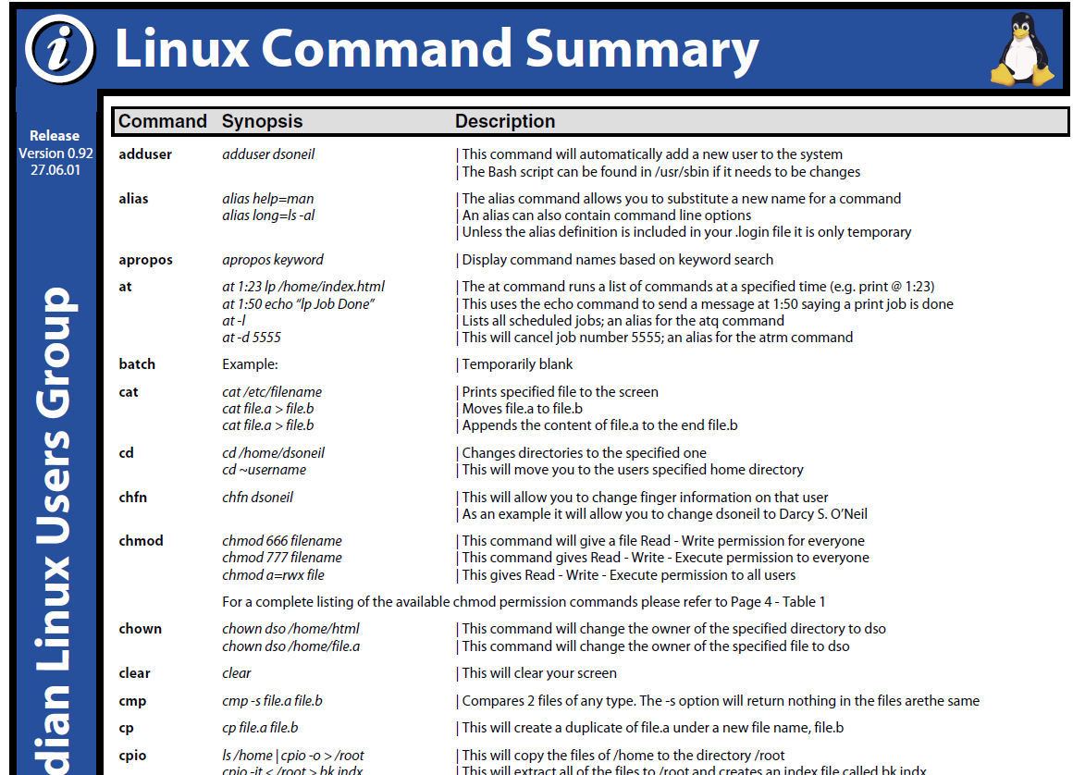

Slide 11
Left Brain/Right Brain
UNIX - programming
SSN NIC - Network
Serial 38400 baud

Slide 12
NET Manager Commands
Net_Mgr Reference - net_mgr is a CLI based on the [NetManager] API.
Usage
Usage: net_mgr [-h] [-o ofile] [-s] [-S <v6>] -d <v6>|-i <rf_itf> type [clear]
-h help (this message)
-d address of the ncc you are messaging
-i RF card you are messaging
-t timeout in seconds to wait for a response
-s display OSTime and system_time
-o The file to write the net_mgr request to instead of sending it
-S Set source address in IPv6 message
net_mgr -i image list
net_mgr -i nodeq 0

Slide 13
Python control of Net Manager
import subprocess
import shlex
netmgrcmd = "net_mgr -i image list"
def callnetmgr(netmgrcmd):
print("****"+netmgrcmd)
netmgr_resp = subprocess.check_output(shlex.split(netmgrcmd),shell=False)
nmresults=netmgr_resp.split()
print(netmgr_resp)
def main():
nmcmds = {'ilist':"net_mgr -i image list",'sword':"net_mgr -i conf phy phy_start_word", \
'ltime':"net_mgr -i time local",'nq0':"net_mgr -i nodeq 0",'nq1':"net_mgr -i nodeq 1"}
for icmd in nmcmds:
callnetmgr(nmcmds[icmd])
main()

Slide 14
Net Manager Examples / Demonstration
List Firmware versions
Show start word
Show local time
Display Nodeq 0 & Nodeq 1 statistics
Read Meter C12.19 Table 1
GE I210+c
L&G
Check Streetlight status
Control a Streetlight dim level
Initiate a 900 mhz spectrum scan
Show the results from a previous spectrum scan
Min,Max,Avg RSSI for 83 channels

Slide 15

Applications

Slide 16
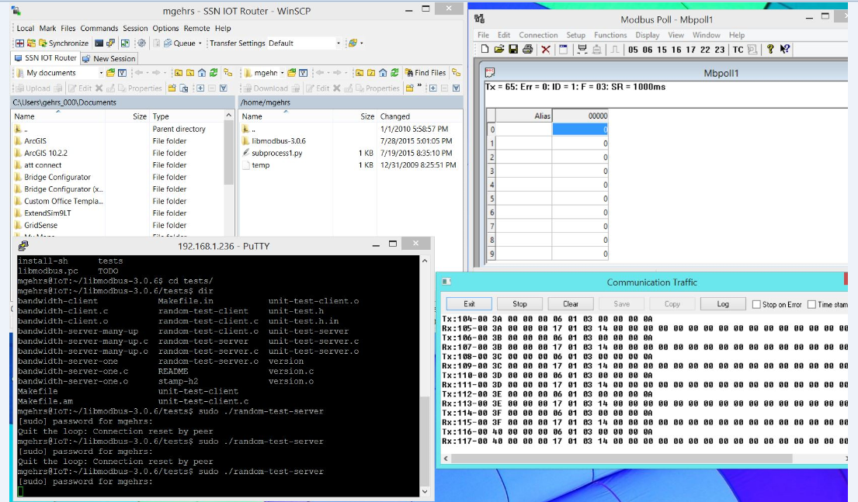
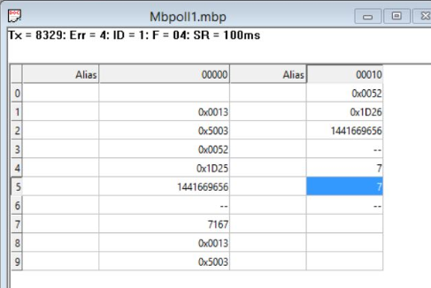
Modbus Application

Slide 17





Street Furniture Advertising
fbi -T 2 -a -t 2 -e -blend 1000 *.JPG

Slide 18

What is missing? Application Protocol

Slide 19
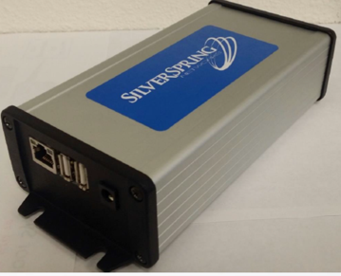

So What is an IOT Router?
FSU (on steroids)
Applications platform
Field tool
Lab testing
Stress testing
Distributed computing
Protocol converter

Slide 20
Security
Travis to provide

Slide 21
Road Map
Bill Pugh to provide

Slide 22

Next Steps
Remote Configuration + Monitoring
SLV
Install CERTS
Protocol support – Modbus, DNP,….
Applications protocol – Open Smart cities protocol
Firmware download/update
Transport protocols – MQTT, DDS

Slide 23


